Slide 1
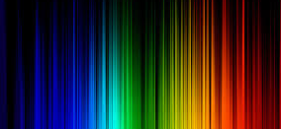
COLORS
Starter

Slide 2
WHITE

Slide 3
BLUE

Slide 4
GREEN

Slide 5
BLACK

Slide 6
YELLOW

Slide 7
RED

Slide 8
BROWN

Slide 9
PURPLE

Slide 10
GRAY

Slide 11
PINK

Slide 12
ORANGE

Slide 13
LET’S PRACTICE!
What’s your favorite color?
What colors are your clothes today?

Slide 14
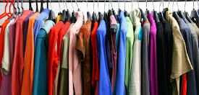
CLOTHES
Starter

Slide 15
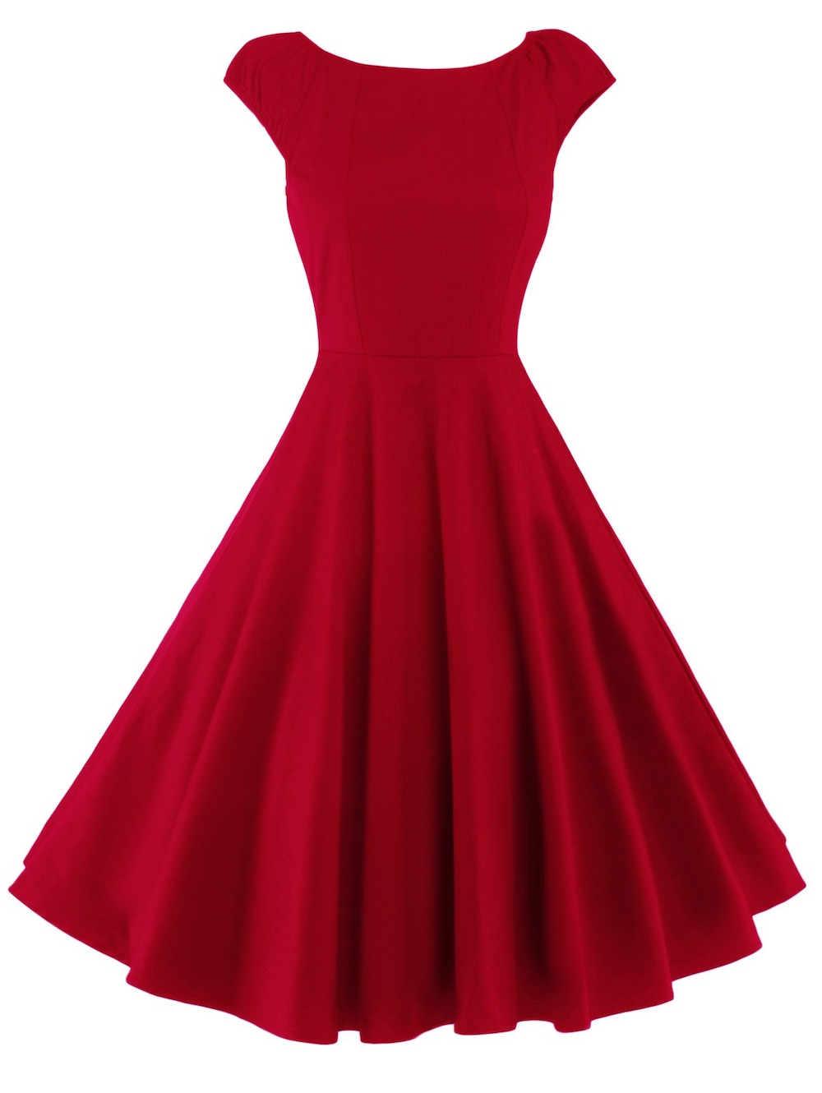
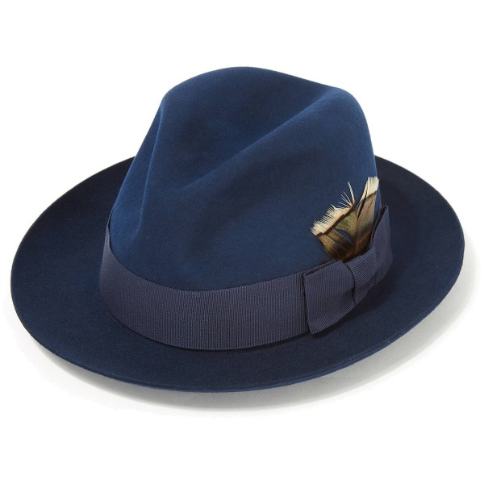
DRESS
HAT

Slide 16
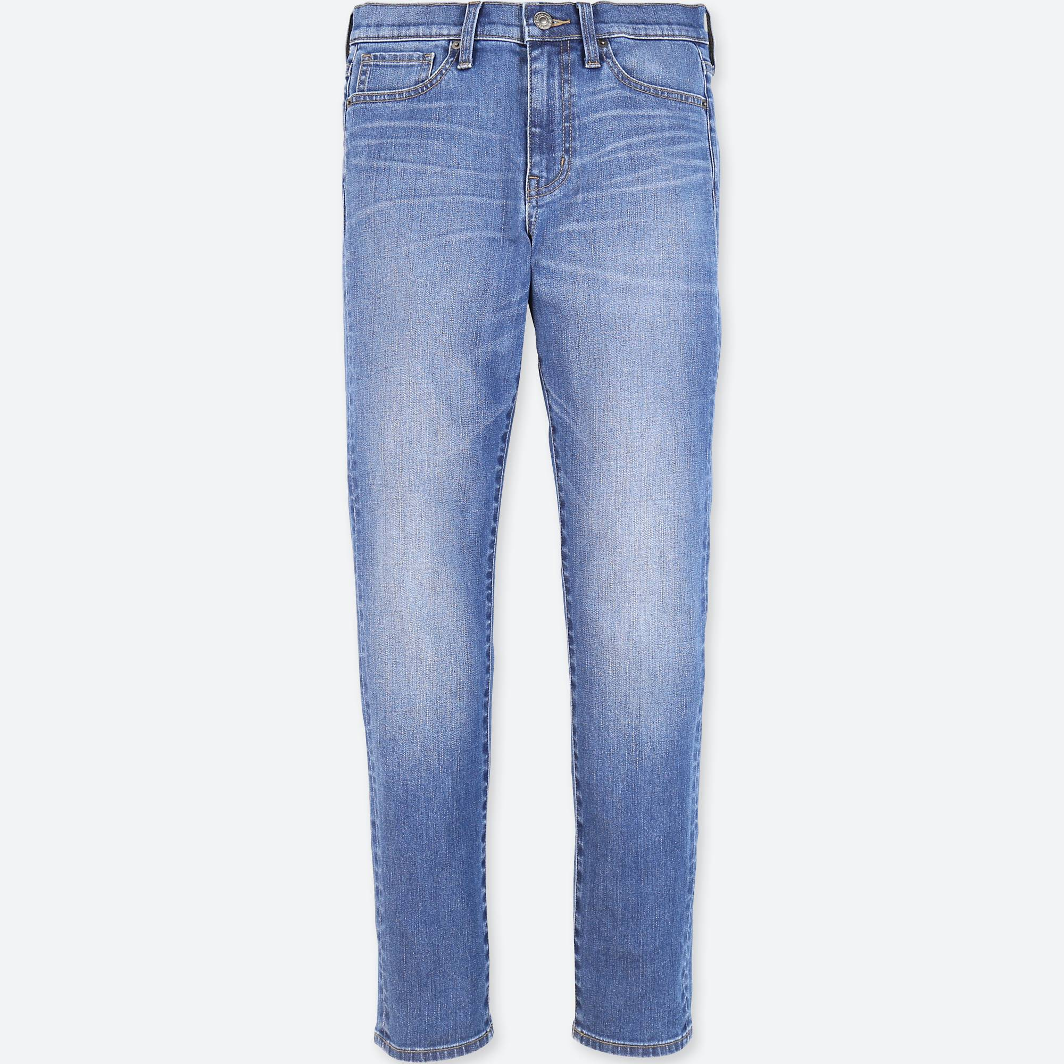
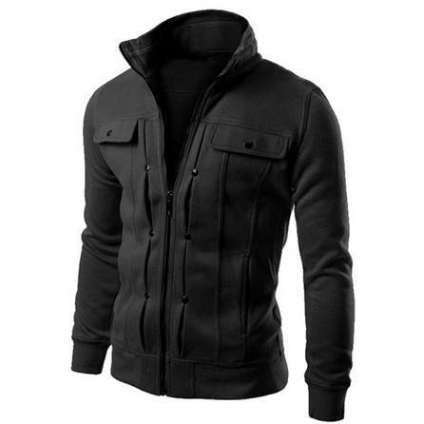
JACKET
JEANS

Slide 17
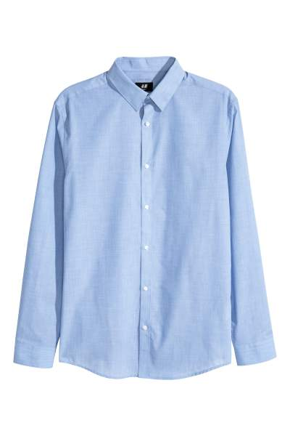
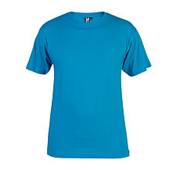
SHIRT
T-SHIRT

Slide 18
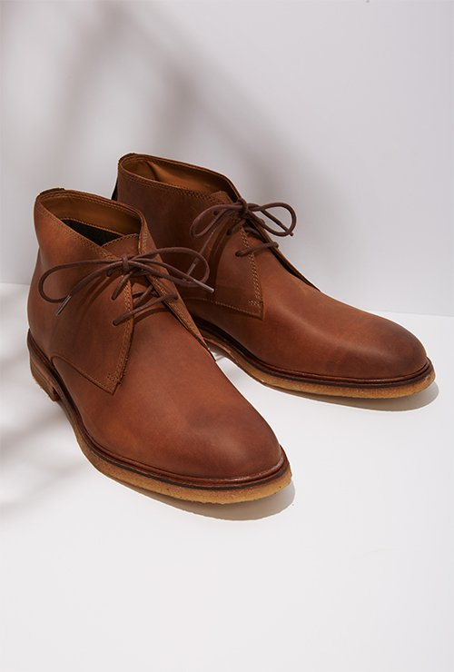
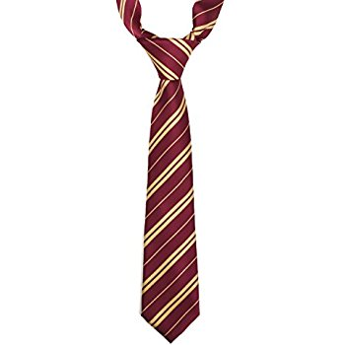
SHOES
TIE

Slide 19
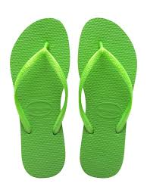
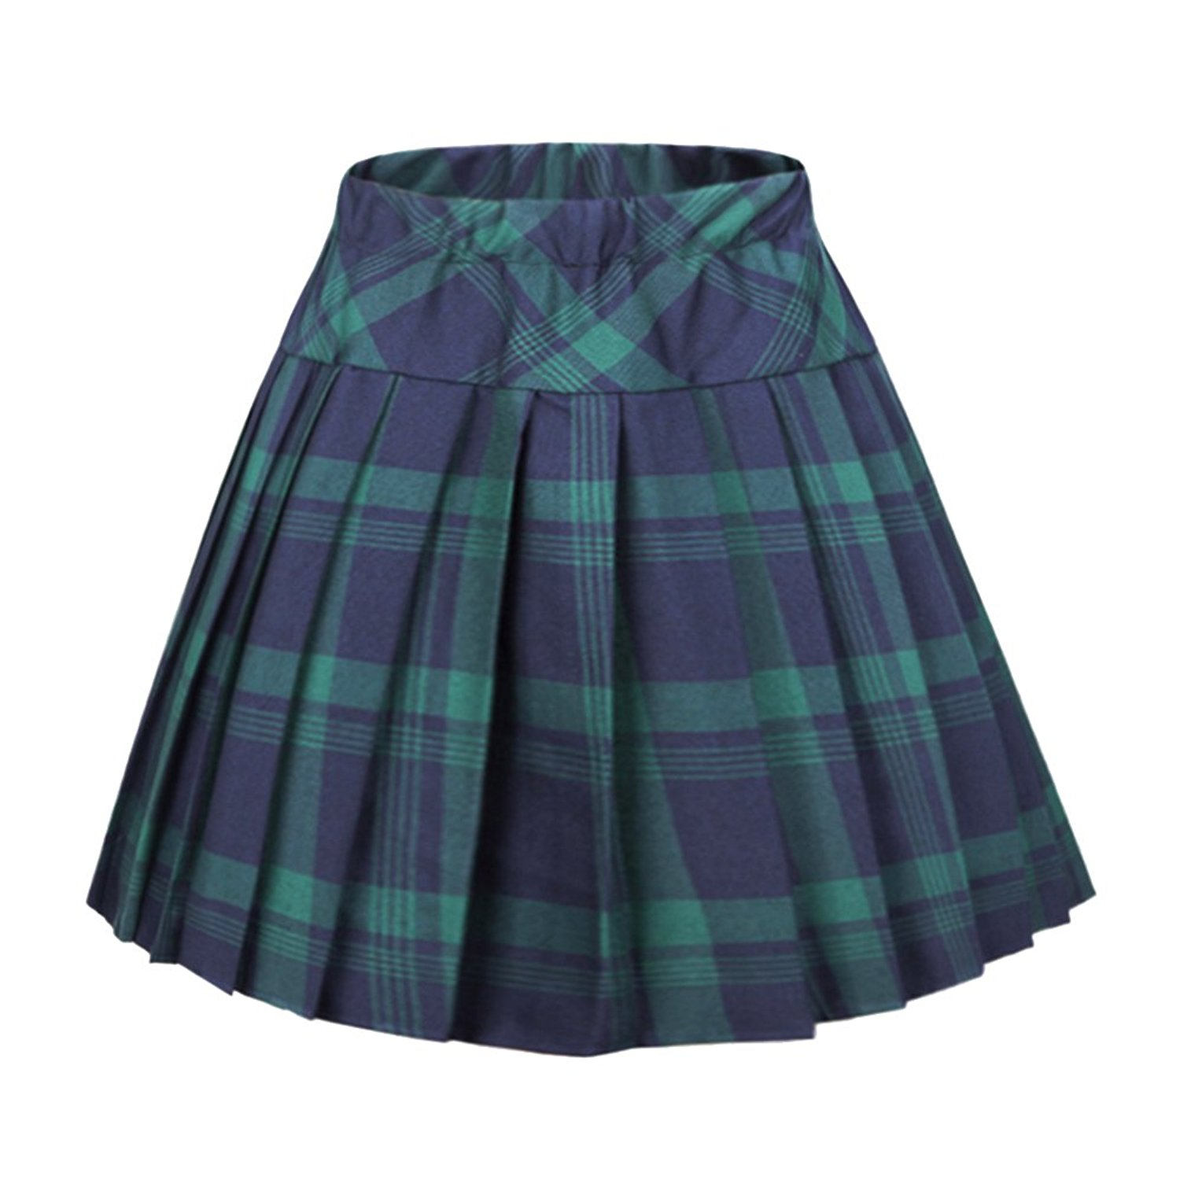
FLIP FLOPS
SKIRT

Slide 20
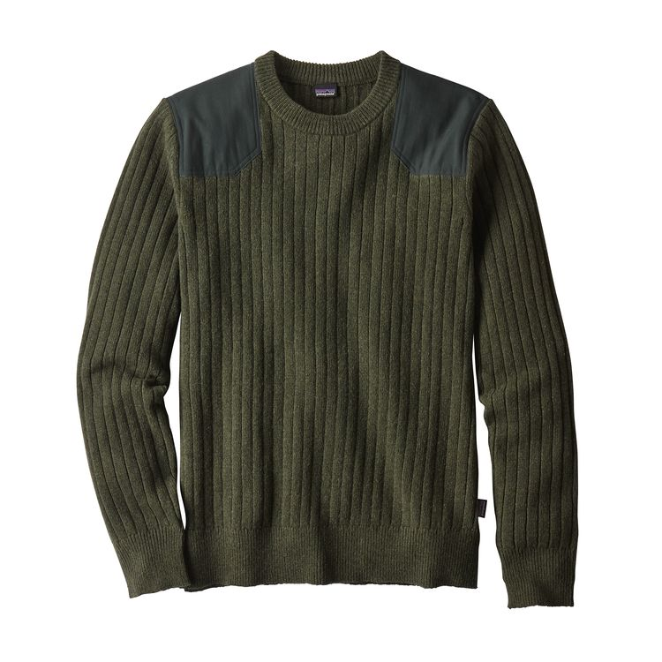
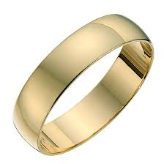
RING
SWEATER

Slide 21
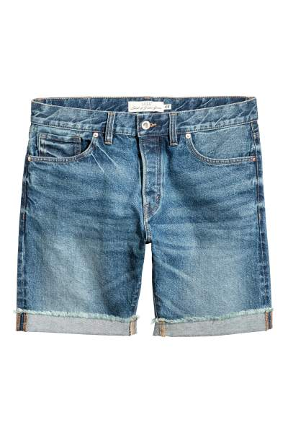

SHORTS
GLASSES

Slide 22
LET’S PRACTICE!
What are you wearing?

